Slide 1
Software Development in Relation Algebra with Ampersand
using RA as a programming language, and generating complete information systems.
Stef Joosten (Open Univ. NL, Ordina)
Notes:
In our society, it seems almost impossible to produce satisfactory information systems.
This software crisis has been around us since computers are being used in organizations for administrative purposes.
I strongly believe in formal software development to resolve this crisis.
Relation Algebras offer powerful magic that can make systems secure, that can make them comply, and that can make them work for us.
This belief has fueled a collective effort of a small number of people to develop a software generator called Ampersand.

Slide 2
What characterizes Ampersand?
relation algebra
heterogeneous (typed)
specialization
Kleene star
one interpretation in sets of pairs
one interpretation in natural language

Slide 3
Information Systems?
Hawaii
Micro example: Students who want to go on a trip must qualify by passing particular courses.
An information system:
has a database (to allow simultaneous users)
has interfaces (to view the right data)
has rules (to comply with business policies)

Slide 4
RELATION required[Subject*Destination]
RELATION pass[Subject*Student]
RELATION attends[Student*Destination]
RULE attends |- pass~/required~
VIOLATION ( TXT "Student ", SRC I, TXT " cannot go to “
, TGT I, TXT " without passing ", TGT required~)
INTERFACE Overview : '_SESSION'
TABS [ Students : V[SESSION*Student]
COLS [ "Student" : I[Student]
, "passed" : pass~
, "Qualify for" : pass~/required~
, "registered" : attends
]
, Subjects : V[SESSION*Subject]
COLS [ "Subject" : I
, "required for trip" : required
, "students that passed" : pass
]
, Destinations : V[SESSION*Destination]
COLS [ "Destination" : I
, "required subject" : required~
, "Qualifying students" : required\pass
, "registered" : attends~
]
]
Real Source Code

Slide 5
The IS enforces rules in 4 ways
No enforcement
Block upon violation of the rule
Let a user solve the violation
Automatic enforcement by compensation

Slide 6
Argument Assistance
MirrorMe
Larger example: Legal professionals get help in building their arguments.
MirrorMe implements argumentation principles, e.g. for legal reasoning (defeasible reasoning)

Slide 7
Programming of automated enforcement
Example: Substitution of placeholders
Mechanism: The computer tries to keep every rule satisfied at all times
Event: A relation changes by adding or deleting pairs. As a result, a rule might no longer be satisfied.
Reaction: The computer changes (other) relations to “restore invariance”.

Slide 8
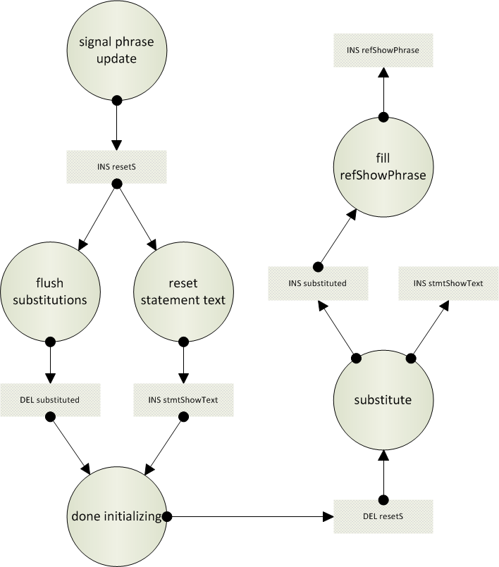
Event Flow (example)

Slide 9
ExecEngine run started
ExecEngine satisfying rule ’signal phrase update’
InsPair(resetS,Statement,Stat623,Statement,Stat623)
ExecEngine satisfying rule ’flush substitutions’
DelPair(substituted,Binding,Bind625,Statement,Stat623)
ExecEngine satisfying rule ’reset statement text’
InsPair(stmtShowText,Statement,Stat623,StmtText,”The employee, [emp], is entitled to [increase].”)
ExecEngine satisfying rule ’done initializing’
DelPair(resetS,Statement,Stat623,Statement,Stat623)
ExecEngine satisfying rule ’substitute’
InsPair(stmtShowText,Statement,Stat623,StmtText, “The employee, James, is entitled to [increase]”.)
InsPair(substituted,Binding,Bind625,Statement,Stat623)
ExecEngine satisfying rule ’fill shownPhrase’
InsPair(shownPhrase,Binding,Bind625,Phrase,James)
ExecEngine run completed

Slide 10
Example: signal phrase update
I[Statement]/\inStatement~;differB;substituted |- resetS
Meaning (in prose)
If a binding that has been substituted in a statement by a different text than its current value, the statement must be reset.
When violated, it is satisfied by inserting all violations into resetS. This is done by custom-made code:

Slide 11
ROLE ExecEngine MAINTAINS "signal phrase update"
RULE "signal phrase update":
I[Statement]/\inStatement~;differB;substituted |- resetS
VIOLATION ( TXT "{EX} InsPair;resetS;Statement;"
, TGT I, TXT ";Statement;", TGT I
)

Slide 12
Event Flow (example)

Slide 13
Problem:
Can we derive the repair actions and generate the code for restoring invariants?

Slide 14
Various options for satisfying:
I[Statement]/\inStatement~;differB;substituted |- resetS
Possibilities:
delete the statement that must be reset;
remove pair from inStatement, or differB, or substituted;
insert the violation in resetS.

Slide 15
Switchboard diagram:
A “switchboard diagram” is a graphical impression that shows how events may affect rules. It also shows events to restore these rules.
The event flow (from the example) corresponds to a path through a succession of switchboards
Partial Switchboard Example

Slide 16
Challenge:
Practical algorithms
for helping the Ampersand programmer
at compile time
to generate code for applications (such as MirrorMe)
that keeps invariants satisfied.
Interested? Please contact stef.joosten@ou.nl

Slide 17
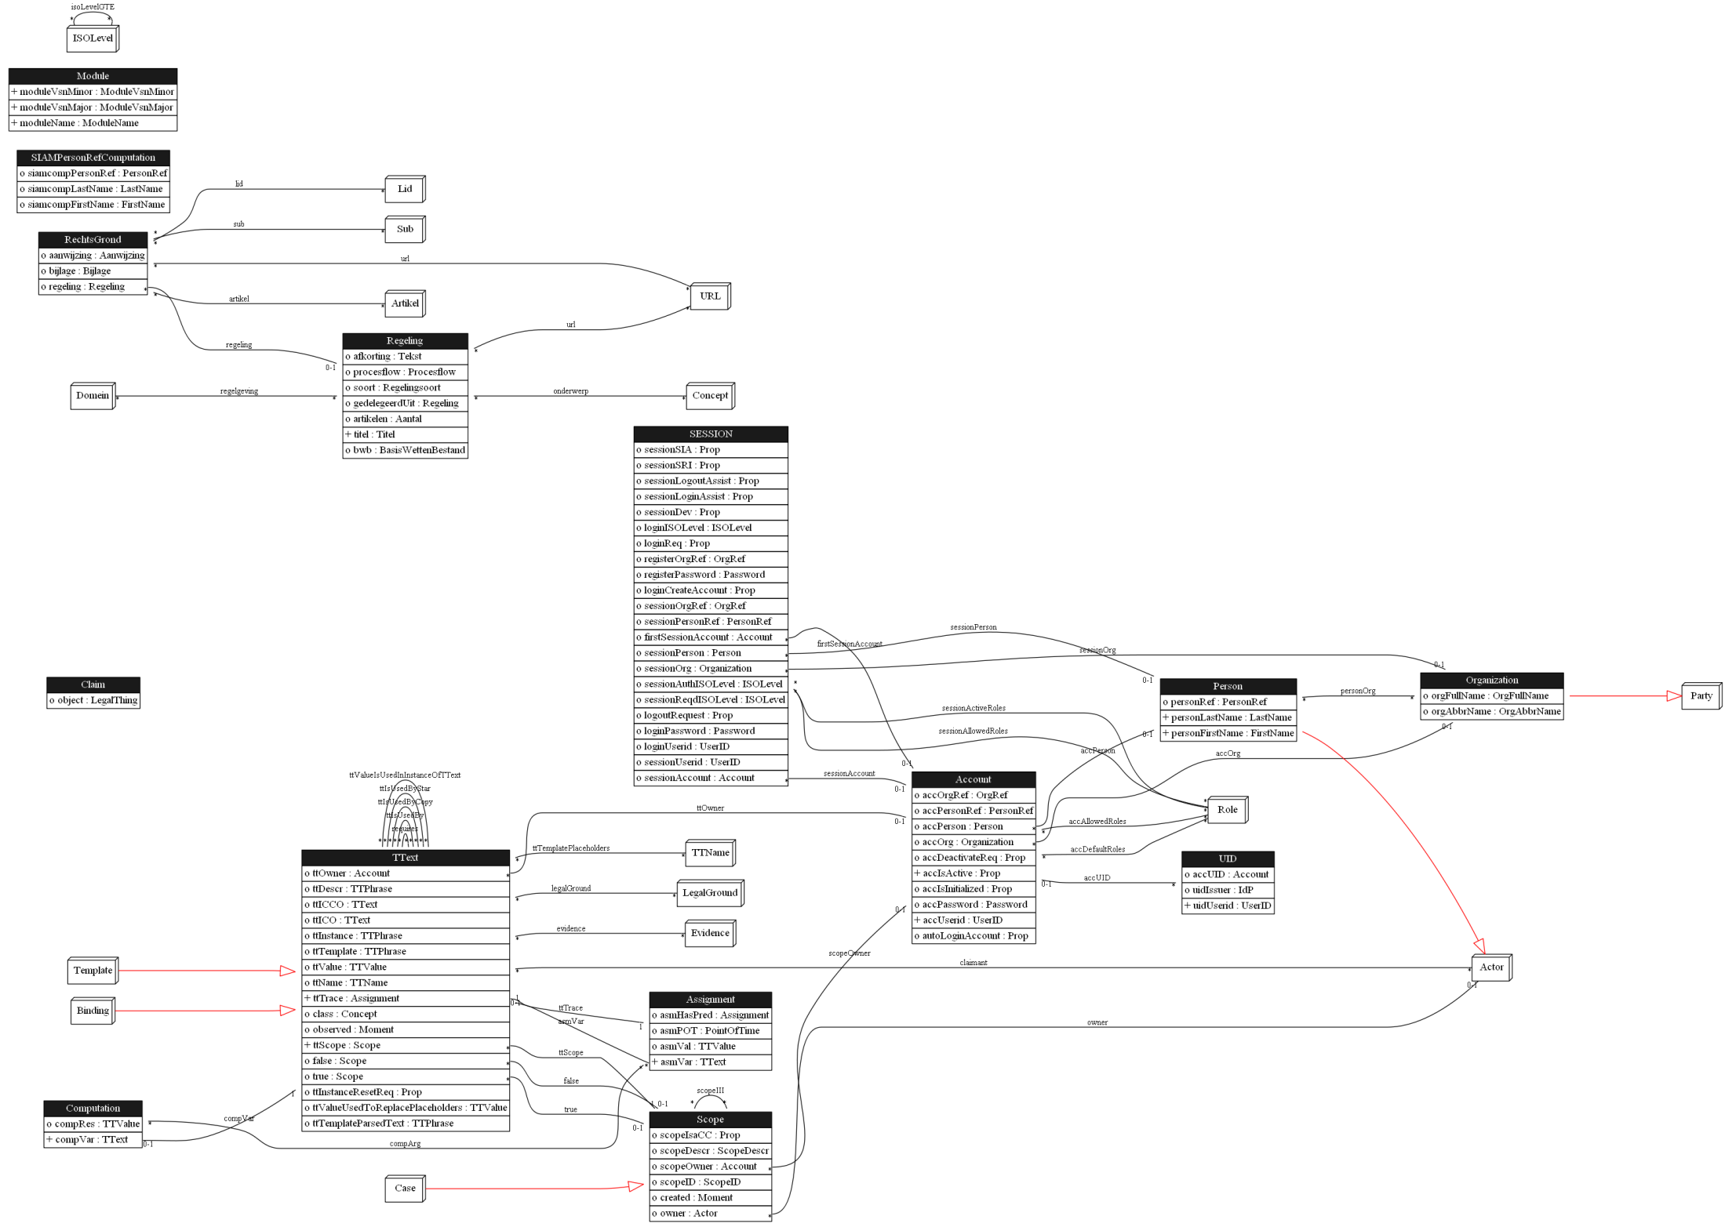

Slide 18


